Slide 1

GROUP PROJECT (Python and Data Analysis)

Slide 2
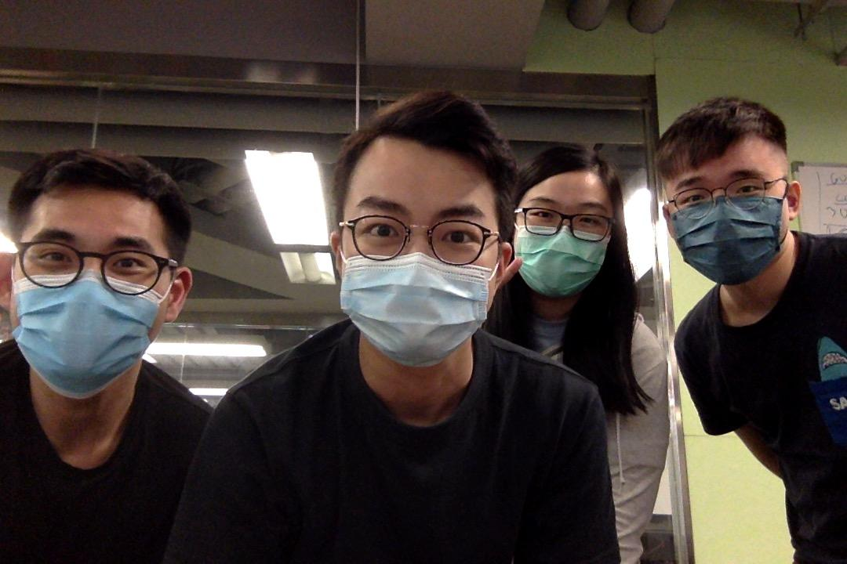
We’re Group 2
Isaac
Hosan
Adriel
Queenie

Slide 3
Why are we doing this?

Slide 4
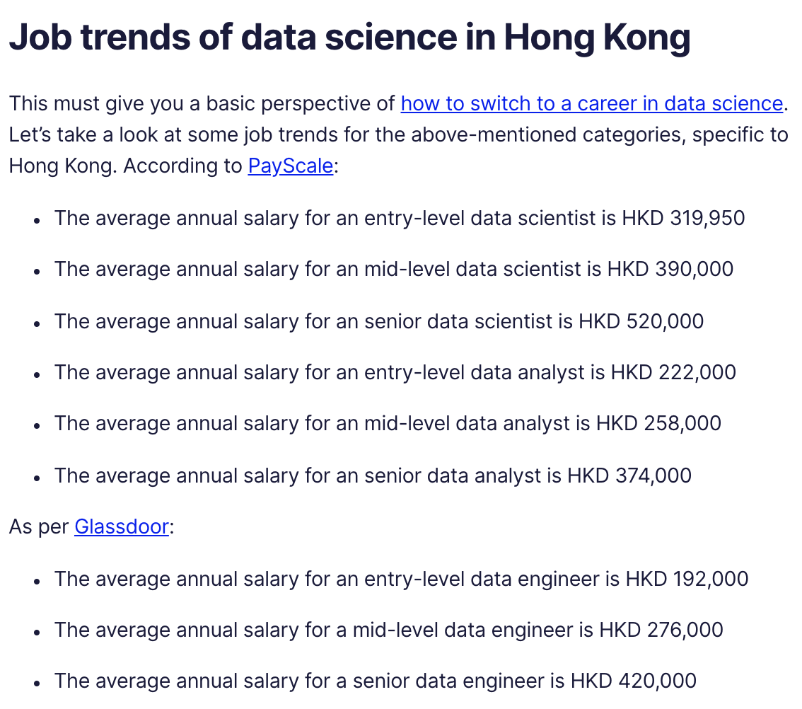

Have you read this article?

Slide 5

Our Goals
To increase transparency and clarify data-oriented job market in Hong Kong.

Slide 6
BUSINESS VALUE
Notes:
employees are the most valuable asset of an organization. So, if you can acquire and retain the talents for your business, the business value would be definitely added

Slide 7
Our Offers
To offer a solution on how to optimise job search for prospective Data Analysts / Engineers / Data Scientists
To provide corporate HRs / recruiting firms with an efficient way of conducting competitive measurement (quant vs qual)
Notes:
employees are the most valuable asset of an organization. So, if you can acquire and retain the talents for your business, the business value would be definitely added

Slide 8
DATA COLLECTION

Slide 9
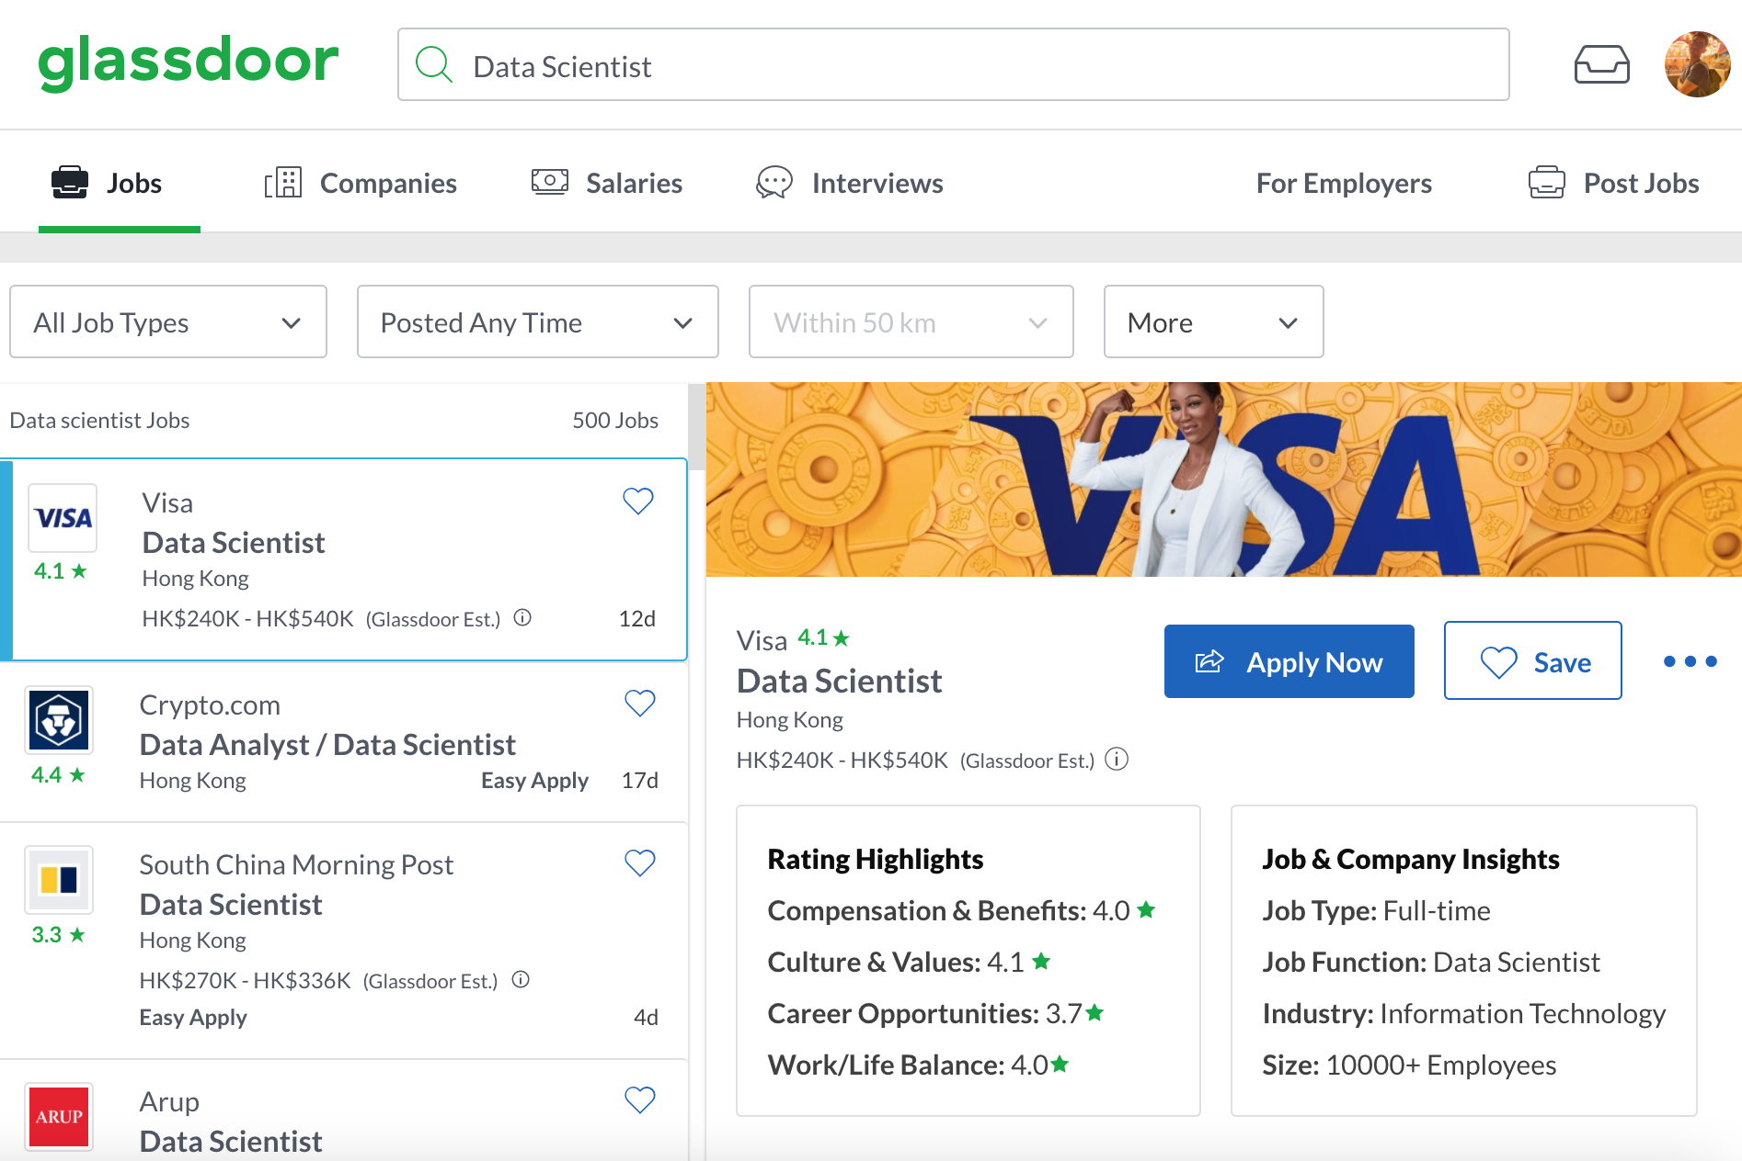
Glassdoor
Scraped multiple pages of job postings for the following roles:
Data Analyst
Data Engineer
Data Scientist

Slide 10
DATA PROCESSING

Slide 11
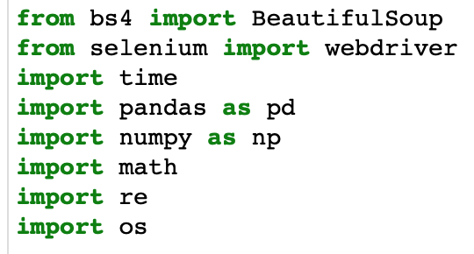
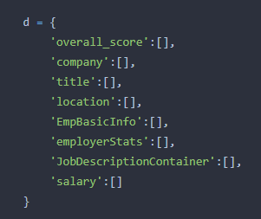
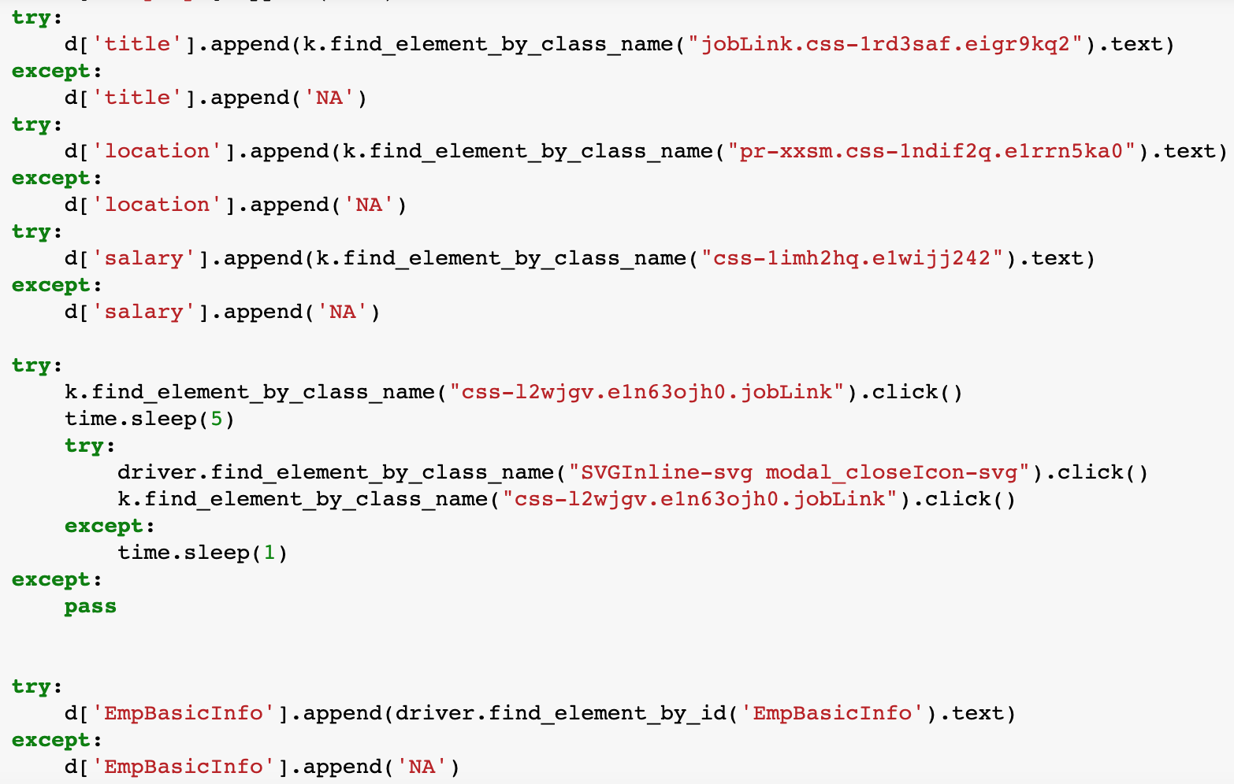
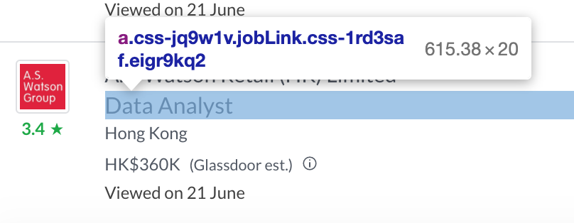
Our Method
1. Scraping
Scraped Glassdoor for each role using:
Selenium
Data processing with:
Pandas, Time, Numpy, OS, Math, Regex

Slide 12
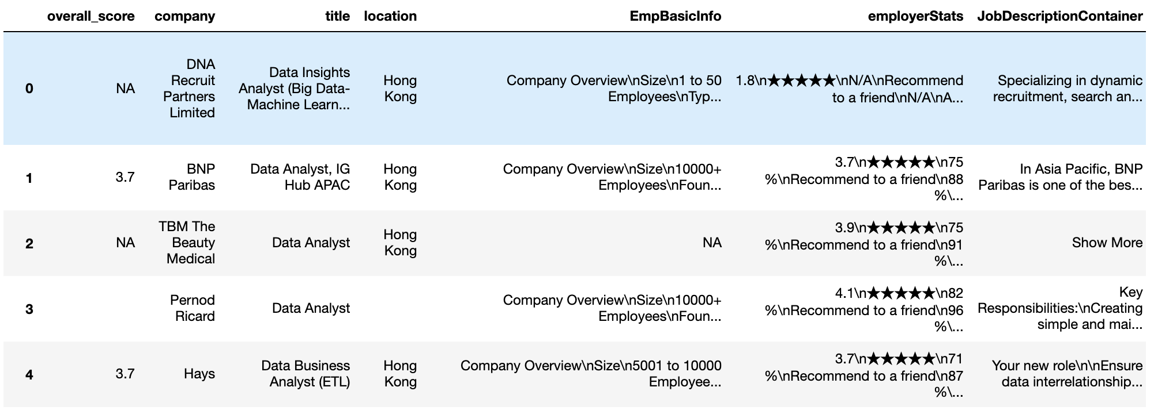
Our Method
2. Merging
Merge 3 data frames (DA, DE & DS) together
Drop any duplicate rows
Drop any entries without company names to ensure high-quality data

Slide 13
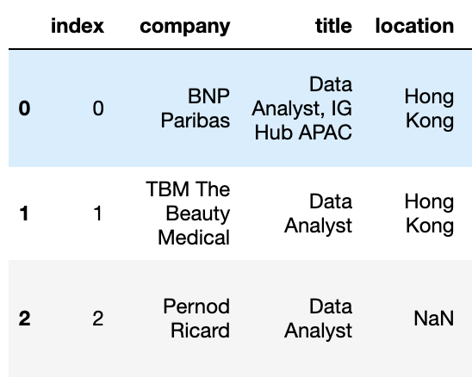
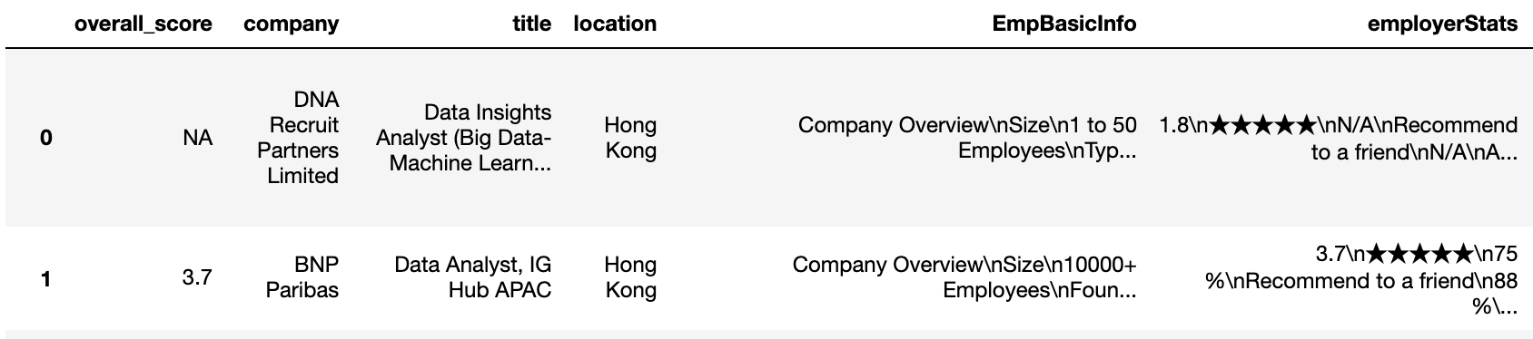
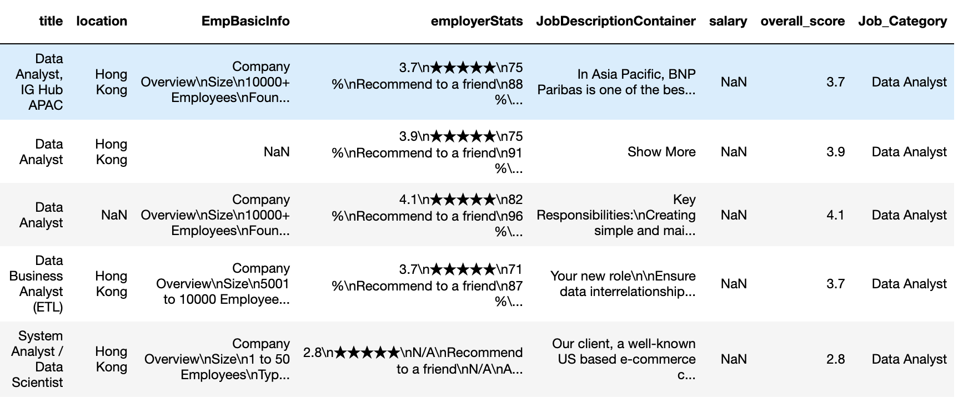
Our Method
3. Clean-up
Drop unnecessary columns
Ensure overall_score is extracted from the “employerStats” column
New column to categorise each role to (1)Data Analyst, (2)Data Engineer, (3)Data Scientist
Merge 3 data frames together
???
☺

Slide 14
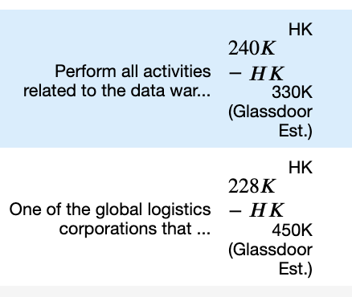
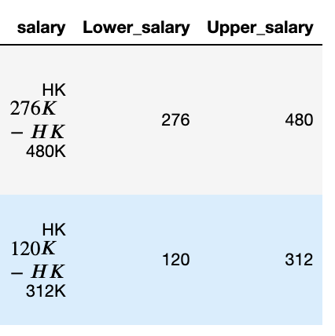
Our Method
3. Clean-up “salary”
Separate into Lower Range and Upper Range

Slide 15
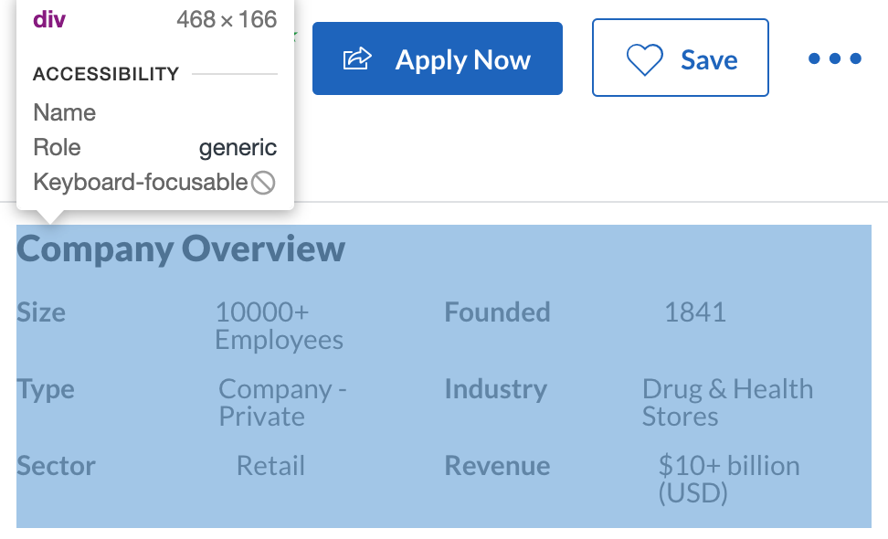
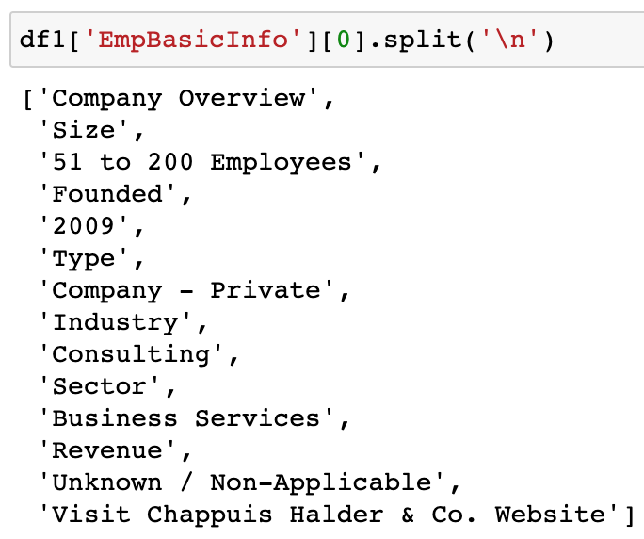
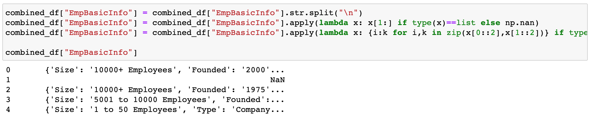
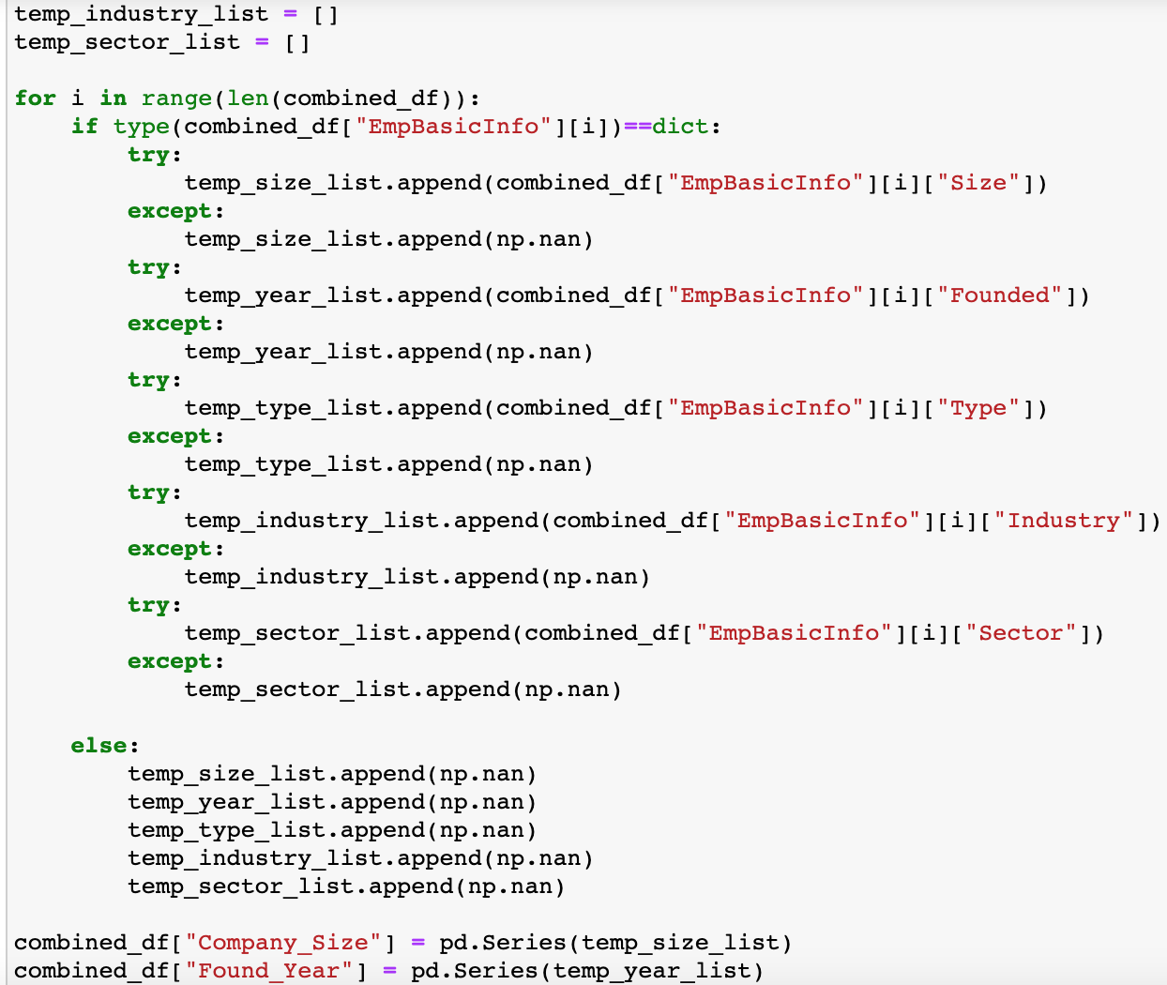
Our Method
3. Clean-up “EmpBasicInfo”
Split extracted strings
Create dictionary for each job posting
Build a temporal list for each intended independent variable
Append each list with extracted value from all created dictionaries

Slide 16
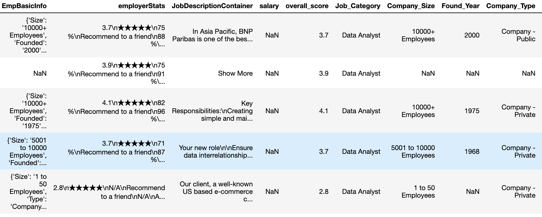

Slide 17
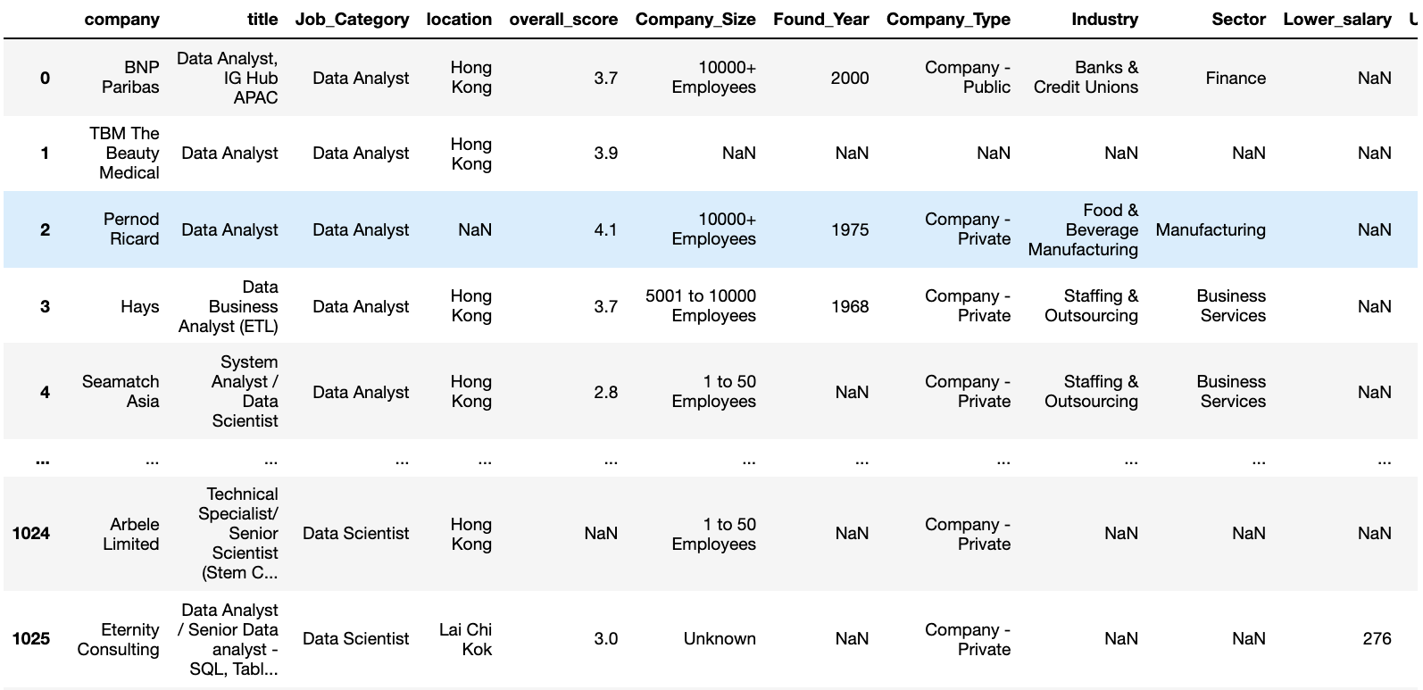
Our Method
4. Final Data Frame

Slide 18
ANALYSIS
The Job Market

Slide 19
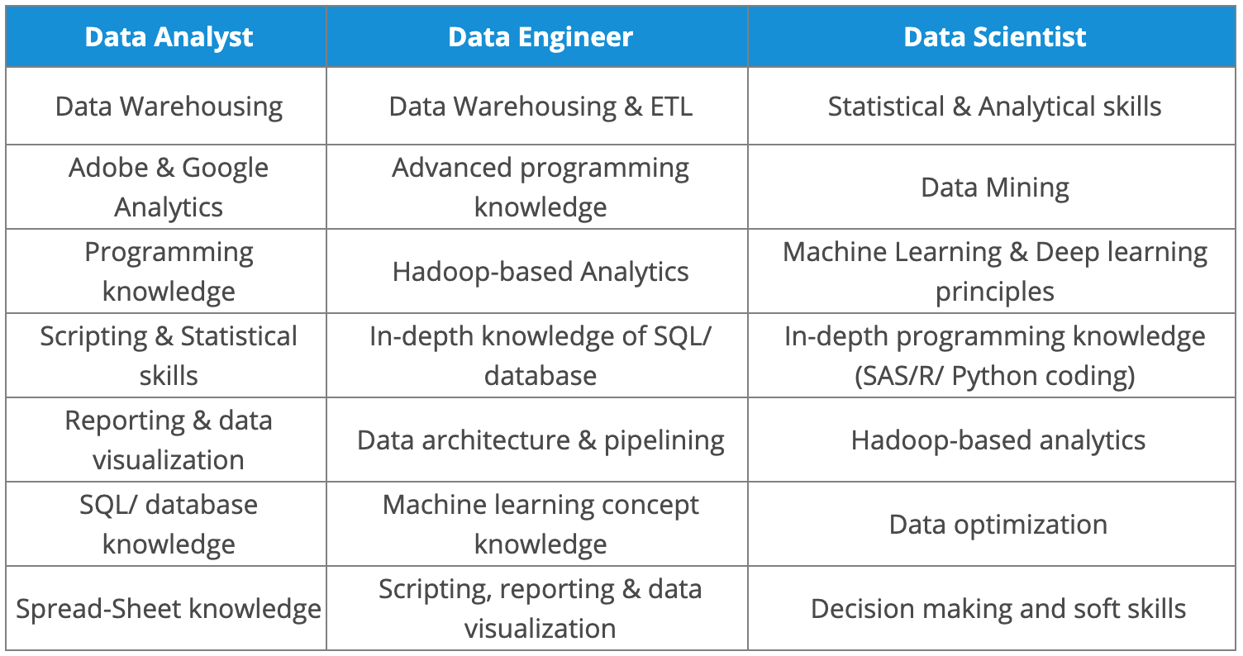
Differentiating between roles

Slide 20
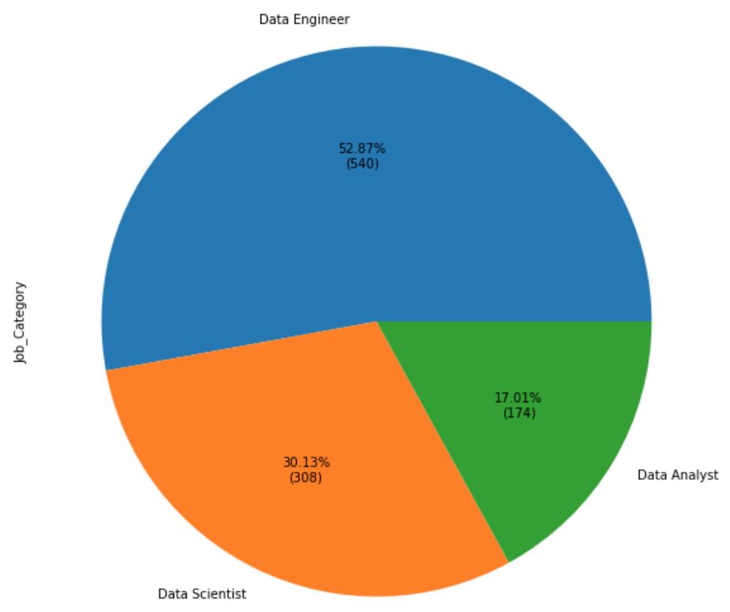
Overall Market
As of 20 June 2021, job postings were dominated by Data Engineer by an exceptionally large margin:
540 Data Engineers
308 Data Scientists
174 Data Analysts

Slide 21
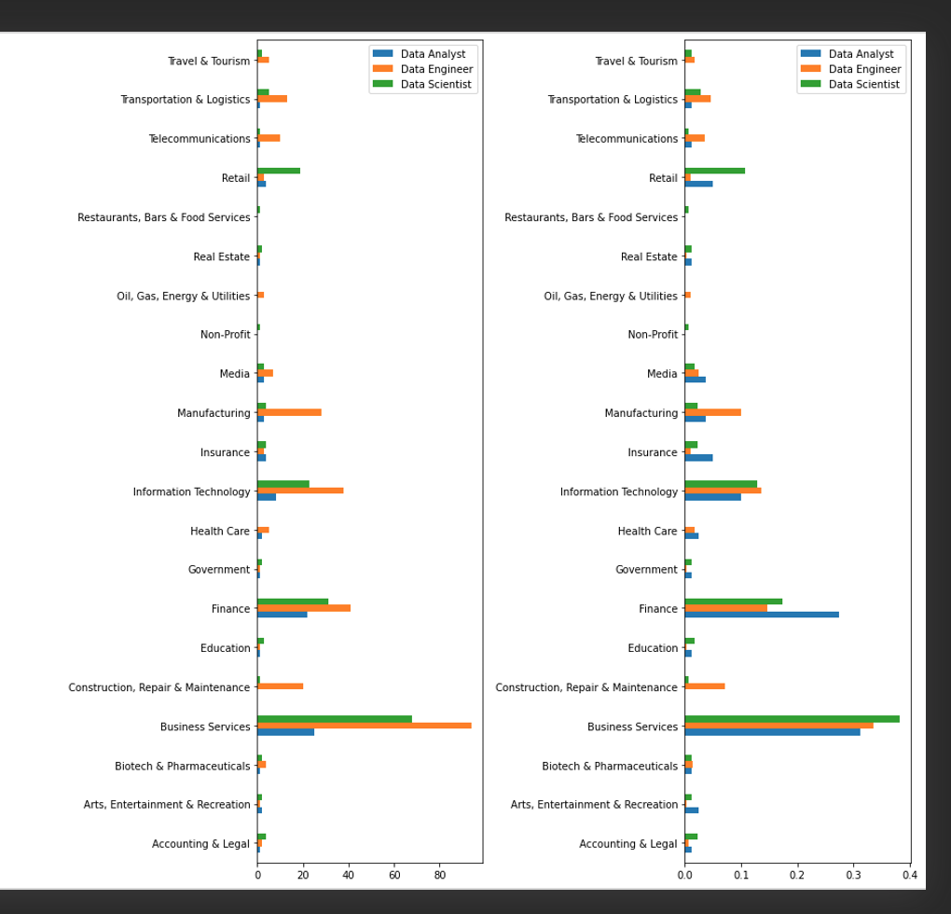
Sectoral Demand
The following sectors lead the demand for data-oriented roles in terms of :
Business Services
Finance
Information Technology
Aside from the TOP 3 (>60%) above:
Applying for Data Engineer roles? Be on the lookout for ones in Manufacturing.
Prospective Data Scientists? Pay attention to the Retail sector.

Slide 22
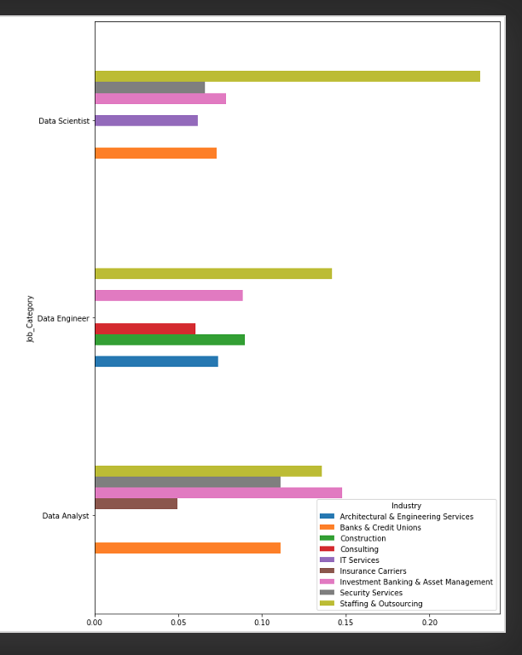
Recruiter Galore!
WOW
Data Analyst Multiple industries already account for 10%+ of job postings, indicating that corporates are familiar with the scope of Data Analyst roles.
Data Engineer / Data Scientist Largely posted by Staffing & Outsourcing firms, representing ~15% and ~24% of such job posts.

Slide 23
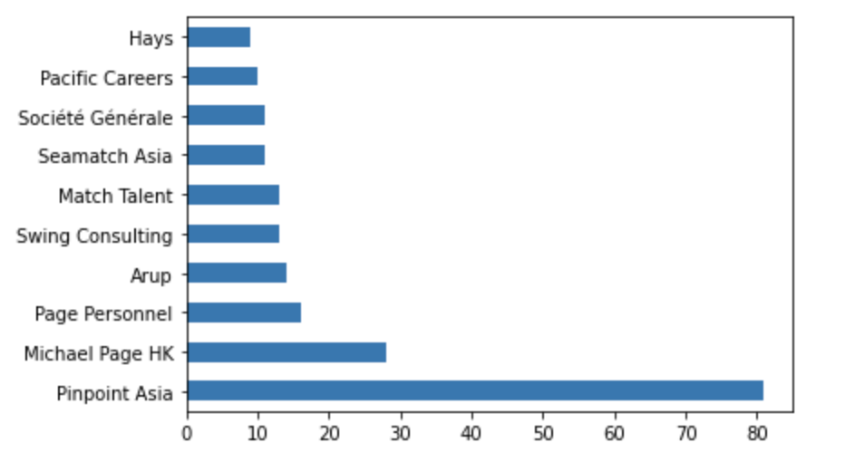
Recruiter Galore!
9 out of 10 of the companies are professional recruiting specialists
Applying for Data Engineer / Data Scientist roles? Be prepared to face the recruiters first!

Slide 24
ANALYSIS Salary per size of companies

Slide 25
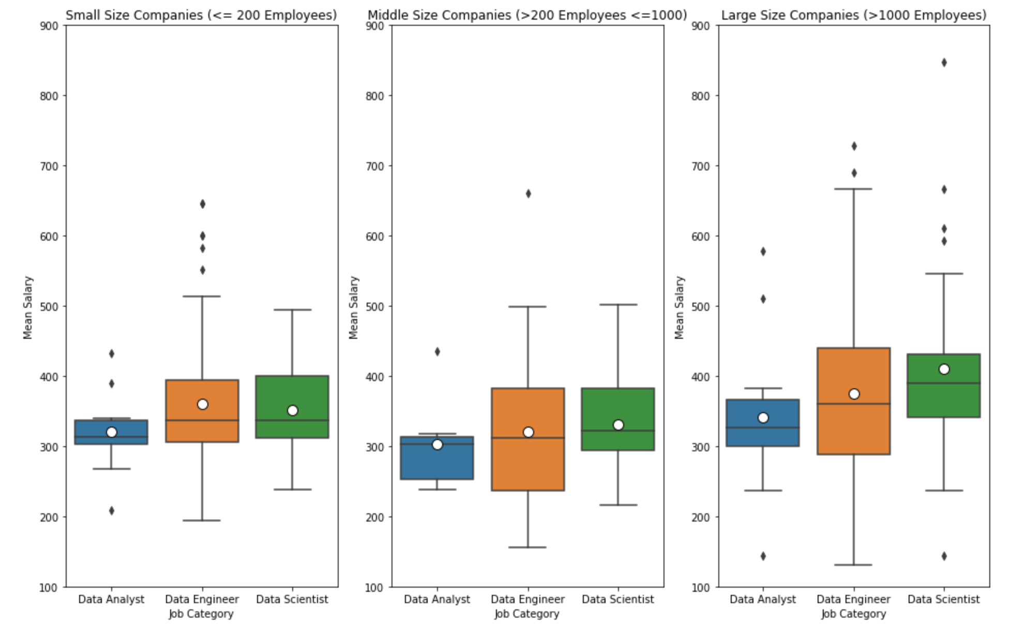
Notes:
All three positions in Large size Company are with higher mean salary than others;
All three positions in Small size Company are with higher mean salary than those in Middle size companies ;
All three positions in Middle size Company are with the least mean salary.

Slide 26
ANALYSIS Overall score per size of companies

Slide 27
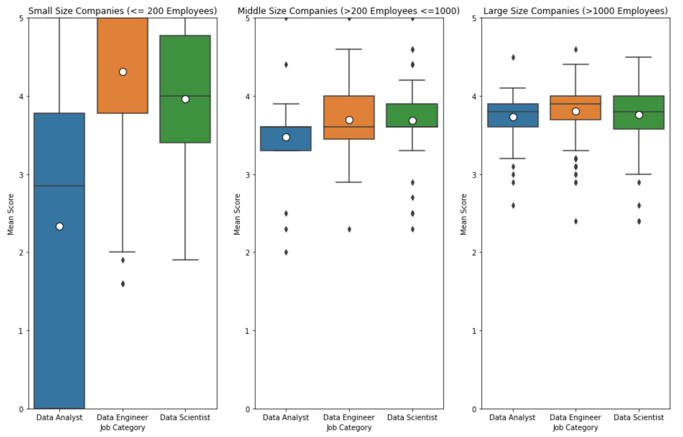
Notes:
The score range for Data Analyst in small size companies are wide => high variance => higher risk employees in small companies would face the below environment
DA: Large_size > Middle_size > small_size
DE & DS: Small_size > Large_size > middle_size

Slide 28
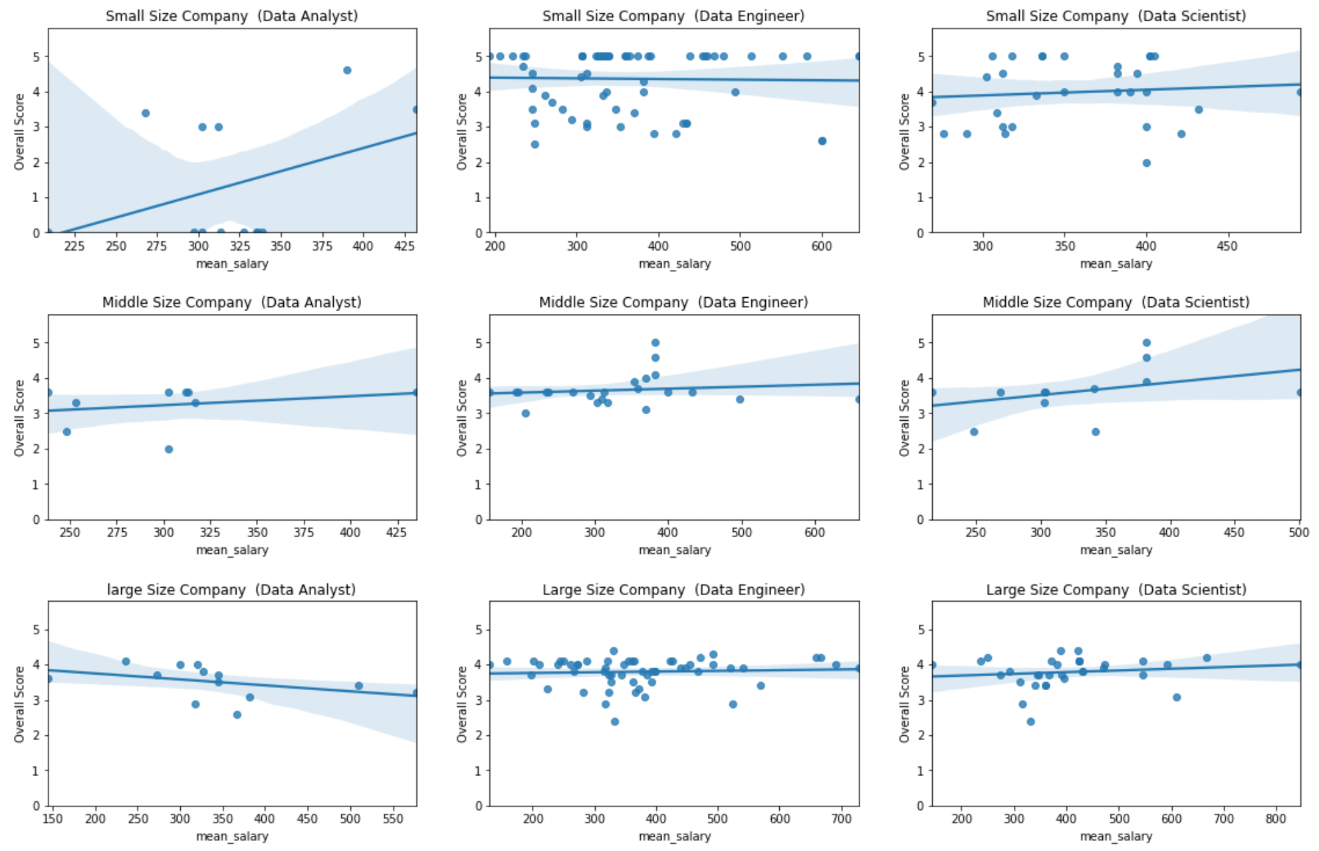
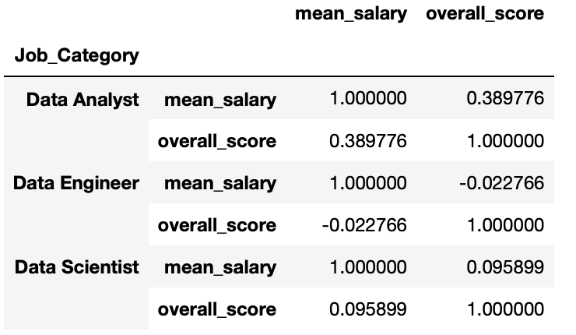
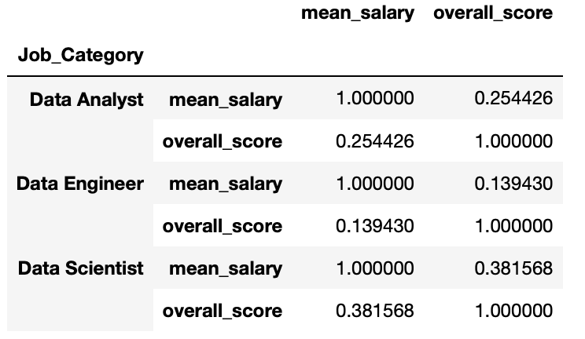
Notes:
No obvious correlation between salary and score

Slide 29
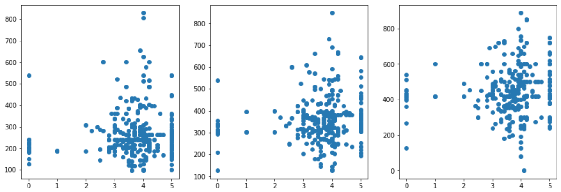
Salary won’t buy your employees’ happiness
Overall score vs Salary
Lower Salary
correlation = 6.5%
Mean Salary
correlation = 10.3%
Upper Salary
correlation = 10.7%

Slide 30
Findings and suggestion in terms of company’s score & salary
Overall Score is the average of the scores below:
Comp & Benefits
Culture & Values
Career Opportunities
Work/Life Balance
Senior Management
For middle-size companies:
They pay the lowest salary and score the lowest overall score from employees
Given no obvious correlation between salary and overall score, our suggestions for them in order to improve the above-mentioned factors to gain higher score from employees are:
→ Retain talents in the company
→ Reduce the turnover cost

Slide 31
ANALYSIS Mean Salary Analysis

Slide 32
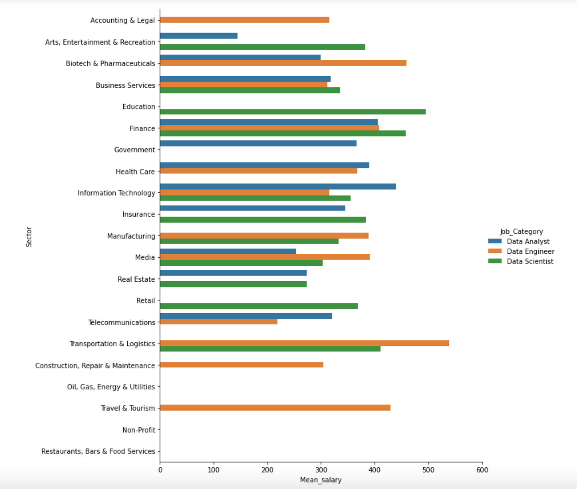

Slide 33
Where can you get the highest salary?
 | Data Analyst | Data Engineer | Data Scientist
Sector 1 | Information Technology HKD 440,000 | Transportation & Logistics HKD 538,100 | Education HKD 495,500
Sector 2 | Finance HKD 406,667 | Biotech & Pharmaceuticals HKD 458,833 | Finance HKD 458,458
Sector 3 | Health Care HKD 390,000 | Travel & Tourism HKD 430,000 | Transportation & Logistics HKD 411,167

Slide 34
Where to consider avoiding?
*But we don’t condone you to entirely avoid these sectors
 | Data Analyst | Data Engineer | Data Scientist
Sector 1 | Arts, Entertainment, & Recreation HKD 144,000 | Telecommunications HKD 219,000 | Real Estate HKD 273,000
Sector 2 | Media HKD 253,000 | Construction HKD 304,300 | Media HKD 303,000
Sector 3 | Biotech & Pharmaceuticals HKD 273,000 | Business Services HKD 311,938 | Manufacturing HKD 332,500
???
Notes:
Hong Kong Jockey Club - Senior Big Data Analytics Modelling Analyst (Retail)

Slide 35
CHALLENGES &
NEXT STEPS

Slide 36
Moving Forward
 | Data Availability | Static Analysis | Incomplete Data
Challenges | Out of 1,022 scraped job postings, only 35.2% of them have salary information | The analysis is conducted based on particular data that was extracted in one single timeframe, that is 20 June 2021 afternoon. | Not enough information regarding required experience level for each job, hard to analyse correlation between experience level & mean salary
Next Steps | Use a more reliable resource with particular emphasis on salary data, e.g. Payscale | Apply automation / machine- centred operation to enable real-time tracking, perhaps machine learning? | Likely apply machine learning to more accurately classify job category and seniority of each posting

Slide 37
CONCLUSION

Slide 38
Our Takeaways
Project
High-quality analysis is not possible without high-quality data
Scrape data with correct extraction methodologies
Data has to be cleaned up properly… and it takes a lot of time
Write your codes clearly
After hundreds of lines, codes become hard to follow
Ensure code writing is easy to trace and understand
Create variables with relevant names

Slide 39
Our Takeaways
Findings
Overall score of a company doesn’t correlate to salary
Corporates should stop thinking they can make their employees happy by offering higher salary
Focus more on culture/values, senior management, work/life balance, advancement opportunities, etc.
Data-oriented roles are becoming more important in Hong Kong
Jan ‘21 (Xccelerate): HKD 192,000 (entry) → HKD 420,000 (senior)
Jun ‘21 (our analysis): HKD 265,000 (entry) → HKD 444,000 (senior)

Slide 40
Q&A

